Slide 1
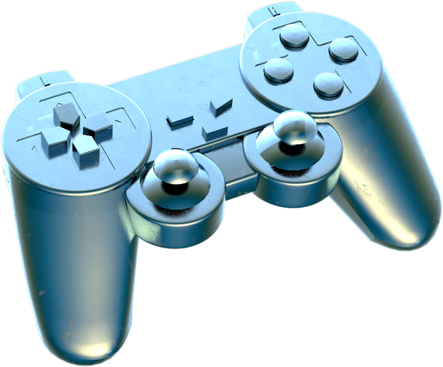

Underwater Robotics for Pearl Harvesting
Addressing the shortcomings of the pearl harvesting

Slide 2

Problem Analysis
Please click the above pic to visualize the problems faced......

Slide 3

Problems Faced
Problems
Description
Equipment failure, entanglement in fishing nets or ropes, or getting trapped underwater leads to drowning.
Drowning
This condition occurs when a diver ascends too quickly, causing nitrogen bubbles to form in the bloodstream. Causes severe pain, joint and muscle problems, paralysis, and even death if not treated promptly.
Decompression sickness (the bends)
Barotrauma injuries
Barotrauma can affect the ears, sinuses, lungs, and other air-filled spaces. It can lead to ear pain, ruptured eardrums, sinus problems, lung injuries, and other serious complications.
Hazardous underwater conditions
Divers may encounter strong currents, low visibility, sharp coral reefs. These factors can increase the risk of accidents, entanglement, injury from marine life, or becoming disoriented and lost underwater.
Lack of oxygen supply
While modern pearl divers use scuba equipment to aid their dives, there is always a risk of running out of oxygen underwater due to equipment malfunction, inadequate air supply, or poor planning

Slide 4
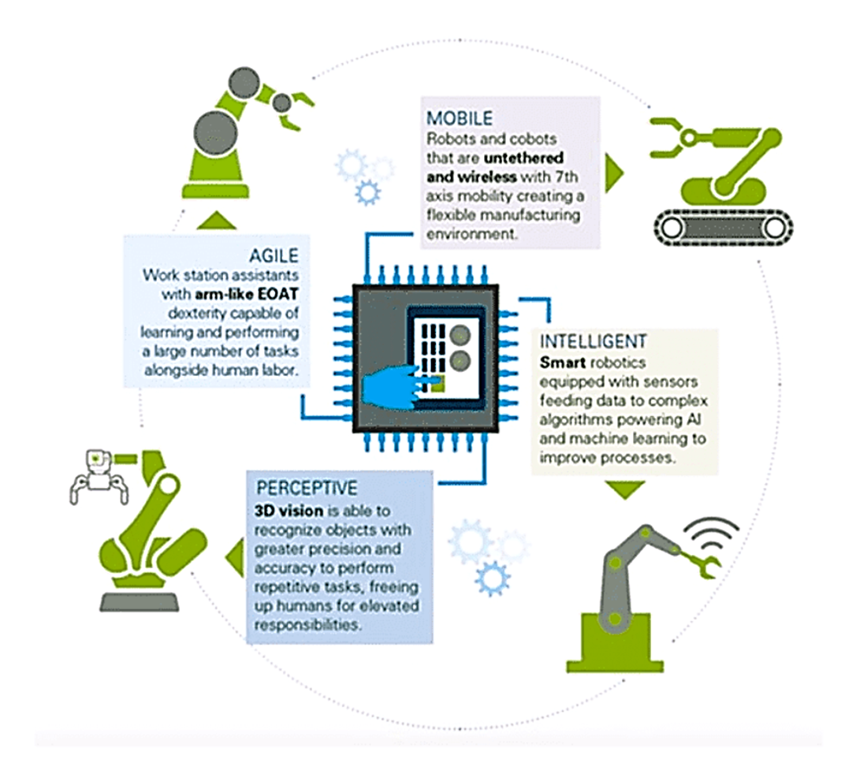
Proposed Solution

Slide 5
Robotics and Modern Technology
A highly sophisticated robotic system, specifically engineered for underwater exploration, is deployed to subaquatic environments with the primary objective of autonomously retrieving precious pearls.
Combining advanced technologies and specialized manipulation mechanisms, this cutting-edge robot adeptly navigates the depths, utilizing state-of-the-art sensors to identify oysters bearing pearls.
With meticulous precision, it delicately extracts these valuable treasures, ensuring optimal efficiency and accuracy in the collection process.

Slide 6
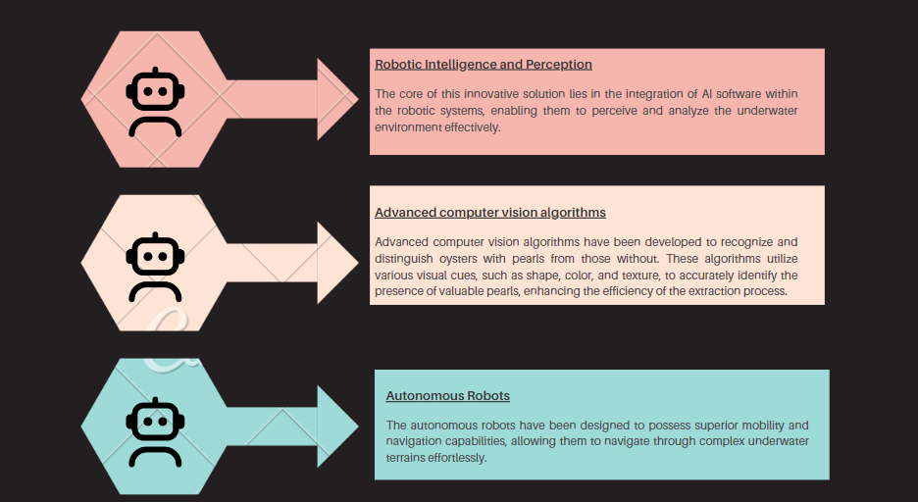

Slide 7
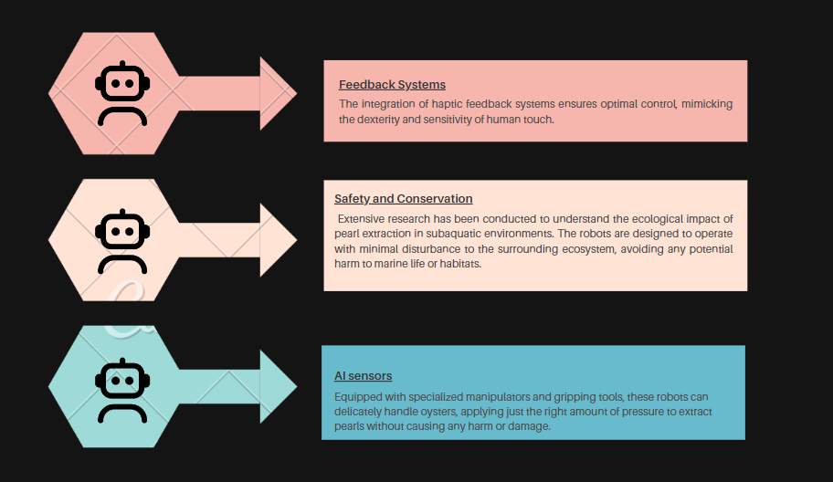

Slide 8

The utilization of autonomous robotic systems for pearl extraction offers numerous advantages over traditional methods.
These include increased efficiency, enhanced precision, reduced risks to human divers, and improved sustainability.
Future Prospects

Slide 9
Additionally, the integration of AI software allows for continuous learning and adaptation, leading to further optimization of the extraction process.
The future holds immense potential for advancements in underwater robotics, paving the way for increased productivity, economic growth, and preservation of delicate marine ecosystems.
Future Prospects

Slide 10

Thank You

